Slide 1
Chapter 18 - Human Decision Making and recommender systems
Luis filipe kopp
Samyr
ramon

Slide 2


CHoices
Recommender Systems: tools for helping people to make better choices [that the chooser will ultimately be satisfied with – following the recommendation or not.]
How people make choices? And the machines?

Slide 3
Johnson & Goldstein (2001)

Slide 4


Slide 5
Check this box if you want to
participate in the organ donors program
Check this box if you do not want to participate in the organ donors program

Slide 6


“What if recommendations are biased?”
Notes:
Green tea – ask sugar for green tea in Japan and manager come and say they don’t have sugar. Ask coffee and they bring sugar.
Free choice x the duty to teach better choice
Healthy food – ifood – pizza or salad?

Slide 7

Perception

Slide 8
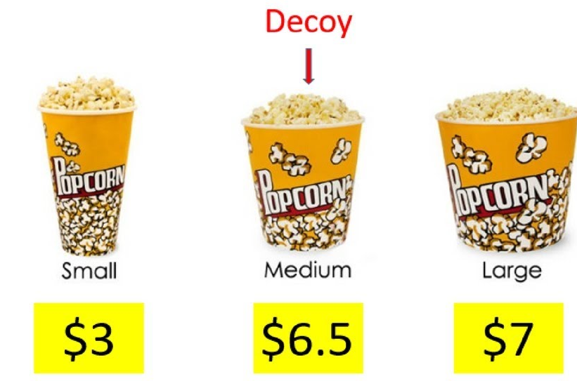
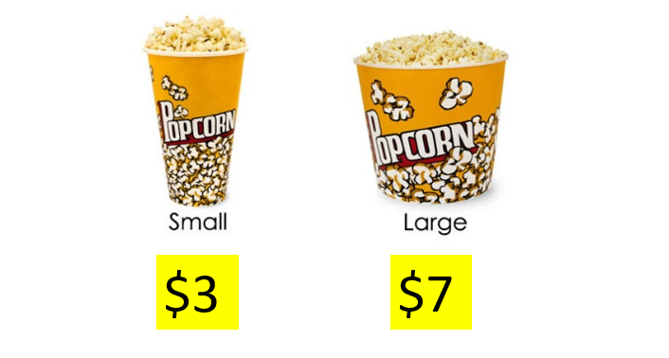
Decoy effect
https://youtu.be/33aaQdtD20k

Slide 9



Slide 10
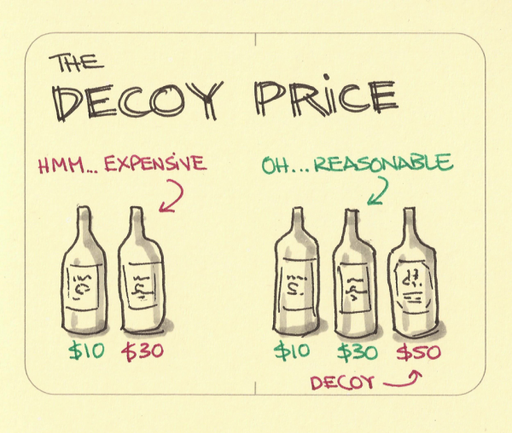

Slide 11
CHoices
Recommender Systems: tools for helping people to make better choices [that the chooser will ultimately be satisfied with – following the recommendation or not.]
How people make choices? And the machines?

Slide 12
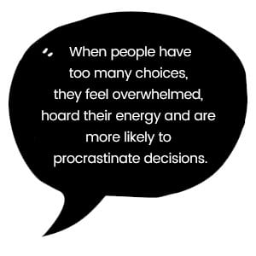

Slide 13
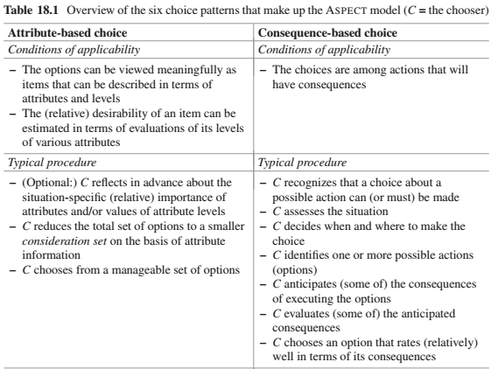
The recommender can help the chooser arrive at evaluations of particular consequences. Even if a chooser knows that a particular consequence will occur, she may have a hard time anticipating accurately how good or bad this consequence will be for her.
a recommender system can help reducing a very large set of options to a smaller consideration set.

Slide 14
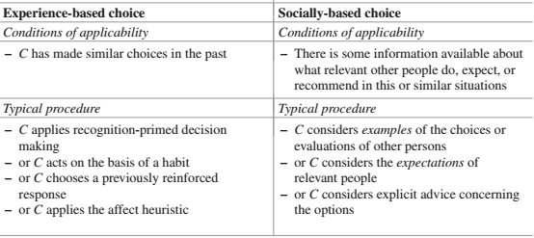
Some trust-based recommender systems take into account the social relationships between the chooser and the other persons whose opinions and choices are being considered
People often allow their choices to be influenced by the examples, or advice of others. If many other people have tried a service/product and rated it positively, their ratings can be seen as a summary of a great deal of relevant experience that it would be impractical for the current chooser to acquire himself.
Recommender systems can be seen as taking over the process of experience-based choice by analyzing the chooser’s relevant previous experiences, while keeping the chooser more in the loop is by helping the chooser to remember and take into account relevant aspects of her previous experience.

Slide 15
